Slide 1

Why you should involve students in your research Highlights from my recent journey in choosing a new research area accessible to students, involving students in the research track in a variety of capacities, and publishing with student co-authors.
Ken Caviness
Physics & Engineering
Southern Adventist University

Slide 2

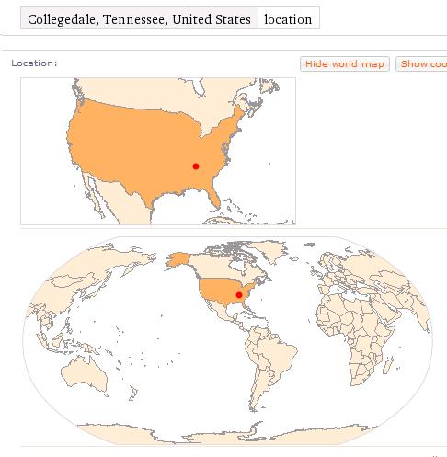

Southern Adventist University Student research involvement is a priority here!

Slide 3

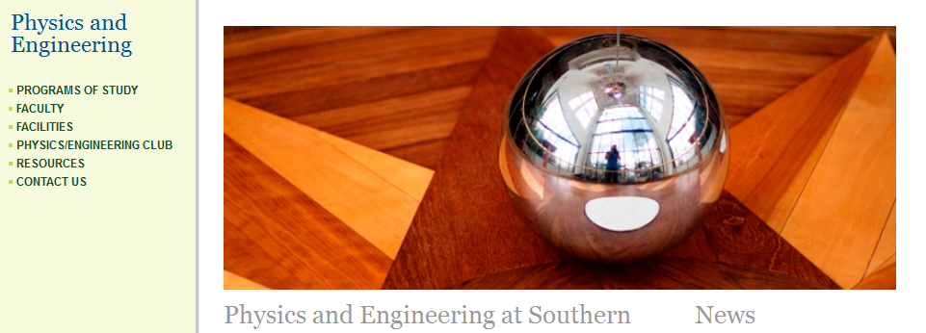
Southern Adventist University Student research involvement is a priority here!
Hickman Science Center:
Physics & Engineering, Computer Science, Biology, Chemistry, Mathematics

Slide 4

Physics @ Southern
Faculty members who have involved students in research:
Ray Hefferlin
Henry Kuhlman
Ken Caviness
Chris Hansen
Blake Laing
Vola Andrianarijaona
100% for full-time faculty

Slide 5
Steps in my journey
Experience in graduate school conducting absolutely new research
An amazing mentor and role model (Ray Hefferlin), who …
continued to do research despite teaching responsibilities, and
actively involved students in ongoing research, and
even changed emphases to allow student collaboration!
Spectroscopy (High Voltage lab equipment) => Periodic Systems of Molecules
I began to think:
Should I become more involved in Hefferlin’s research track, inherit the mantle?
Should I stick to “my own field” (Extended Special Relativity)?
Should I look around for a different answer?

Slide 6
Steps in my journey
Several things came together:
Amateur interest in computer programming
Mathematica for class examples, visualizations, interactive demonstrations
Interest in travel, other cultures, other languages
Claryce’s decision to learn Italian, adding to our use of French
Intriguing article about Stephen Wolfram’s so-called New Kind of Science
Not theoretical or experimental, “mining the computational universe” for real-world analogs
In 2009, the annual NKS Summer School took place in Pisa, Italy. (3 weeks)
I bought by ticket with pro-growth funds, paid for tickets for Claryce and son Erik
They took Italian classes & touristed, I worked 12-hour days in the univ. computer lab!
Besides many themed presentations, we all had to choose a project …

Slide 7
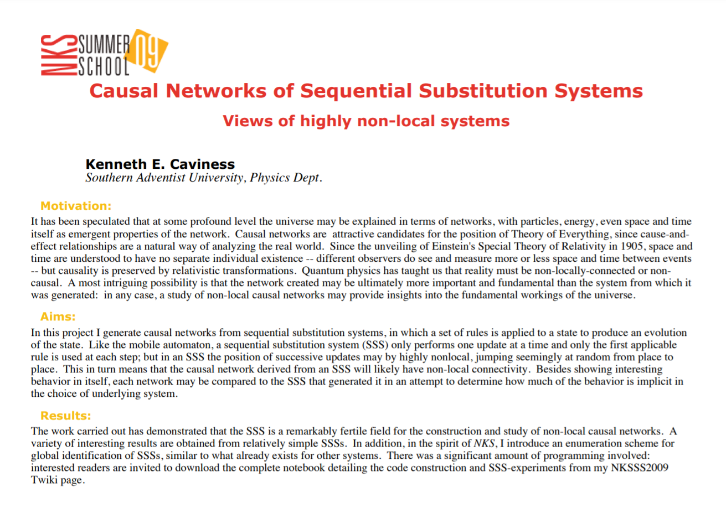
NKSS’09 Poster Session
“Toy” Universes

Slide 8
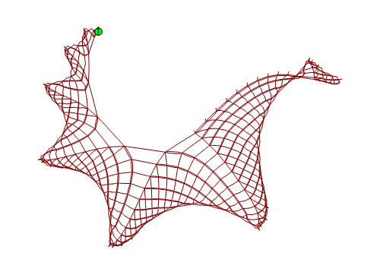
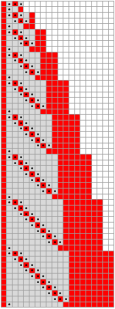
SESSIE NetWorks
Causal networks of SSSs
(Sequential Substitution Systems)
Pattern Hunting!

Slide 9
Simple Rules → Complex Behavior
Strategy:
Take all possible sets of simple rules
Apply them Look for complex behavior
Features similar to the real universe?

Slide 10

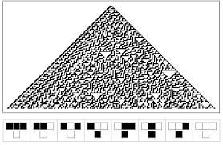
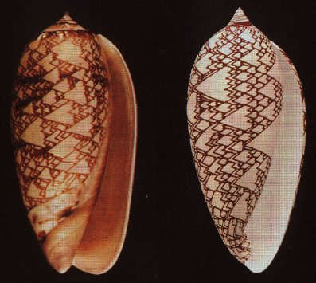
“On the frontier of complexity science since he was a boy, Wolfram is a champion of cellular automata -- 256 "programs" governed by simple nonmathematical rules. He points out that even the most complex equations fail to accurately model biological systems, but the simplest cellular automata can produce results straight out of nature--tree branches, stream eddies, and leopard spots, for instance. The graphics in A New Kind of Science show striking resemblance to the patterns we see in nature every day.” – Therese Littleton
all possible sets of simple rules

Slide 11
Simple Rules → Complex Behavior
Strategy:
Take all possible sets of simple rules
… HOW?! Infinities of Infinities!
Steps in my journey

Slide 12
Enter…
The Complete Enumeration
of ALL Rulesets
But wait, aren’t there an infinite number of these rulesets?
Multiple infinities!
Any number of rules, any length strings, any characters

Slide 13
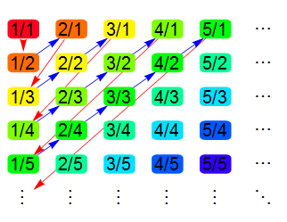
List of all possible rule sets
Inspired by Cantor’s enumeration of all fractions

Slide 14
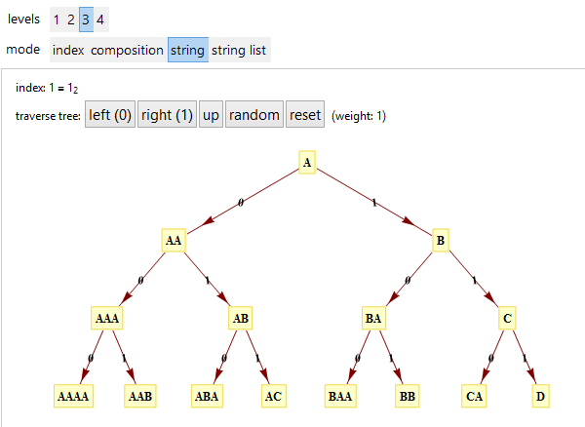
List of all possible rule sets
Inspired by Cantor’s enumeration of all fractions
Universal String Enumeration aka Tree of All Strings
http://demonstrations.wolfram.com/TreeOfStrings/

Slide 15
List of all possible rule sets
Inspired by Cantor’s enumeration of all fractions
Universal String Enumeration aka Tree of All Strings
http://demonstrations.wolfram.com/TreeOfStrings/
Enumeration of all SSS rule sets
http://www.mathematica-journal.com/2011/05/indexing-strings-and-rulesets/
… then run the endless loop, see what appears!
Improved Generalized Enumeration (w/ Christen Case)

Slide 16
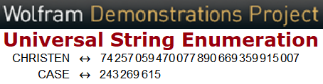
Why involve students?
To give them research experience
Brainstorming – new thoughts!
Generalized SSS Enumeration
w/ Christen Case
Improved explanations
Mine, or student-designed

Slide 17
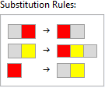
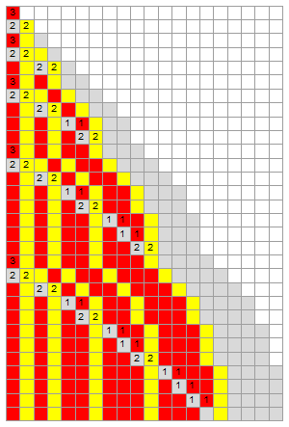
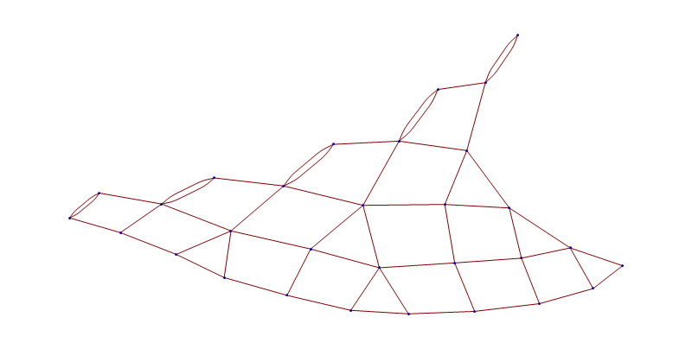
Our first 3-d network: {"AB"->"BA", "AC"->"BCA", "B"->"AC"}
Notes:
This is our first case of a Sessie ruleset generating a three-dimensional causal network. At first the network looks 2-d, as if it could lie flat in a plane, …

Slide 18
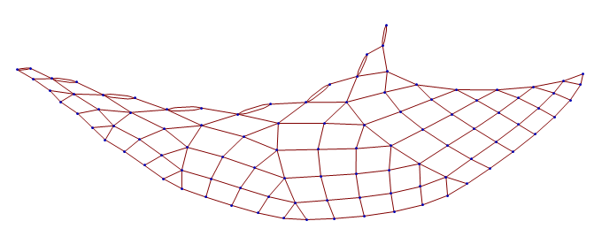
Our first 3-d network: {"AB"->"BA", "AC"->"BCA", "B"->"AC"}
Notes:
But it soon needs to curve in order to lie flat, …

Slide 19
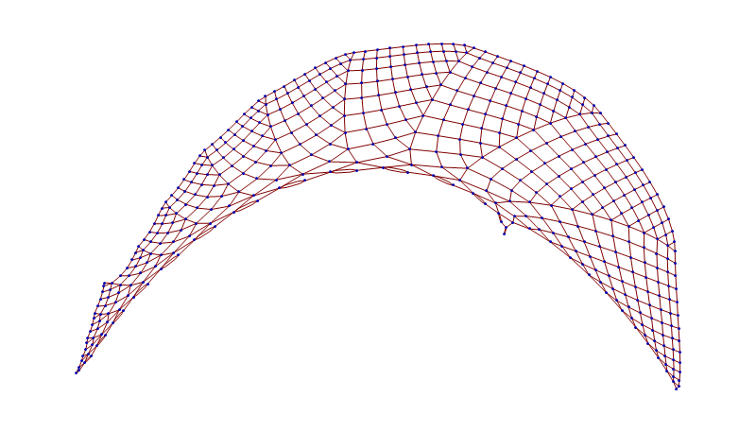
Our first 3-d network: {"AB"->"BA", "AC"->"BCA", "B"->"AC"}
Notes:
And eventually it would curve back over itself

Slide 20
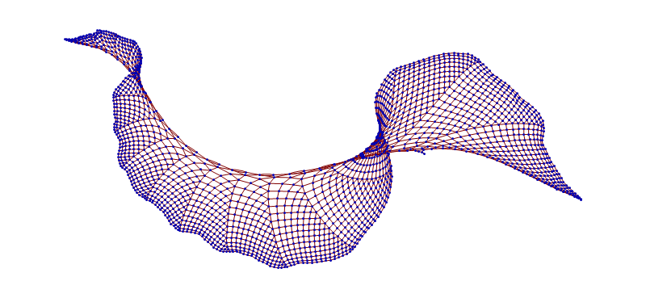
Our first 3-d network: {"AB"->"BA", "AC"->"BCA", "B"->"AC"}
Notes:
Or start filling up a 3rd dimension. This could be arranged to evenly fill a growing cone-shape in 3 dimensions, but it does need 3-d.

Slide 21
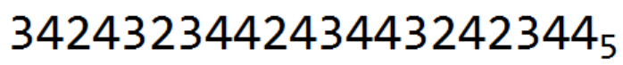
Our first 3-d network: {"AB"->"BA", "AC"->"BCA", "B"->"AC"}
Let’s build this ruleset from its base-5 code identifier:
The subscript “5” just reminds us that here are only 5 allowed digits:
0, 1, 2, 3, 4
Each digit has a precise significance for constructing the ruleset, and this base-5 code identifies and results in one unique ruleset.
Notes:
All sessies are generated from sets of substitution rules, and every ruleset corresponds to a unique code number. Let’s build this ruleset …

Slide 22
Our first 3-d network: {"AB"->"BA", "AC"->"BCA", "B"->"AC"}
Base-5 digit meanings:
0. End this string, insert two empty strings, start a new string with an “A”.
1. End this string, insert one empty string, start a new string with an “A”.
2. End this string and start a new string with an “A”.
3. End this character and start a new character (as an “A”).
4. Increment this character.
Notes:
You’ll start to recognize the meaning of the different digit codes as we work through this example….

Slide 23
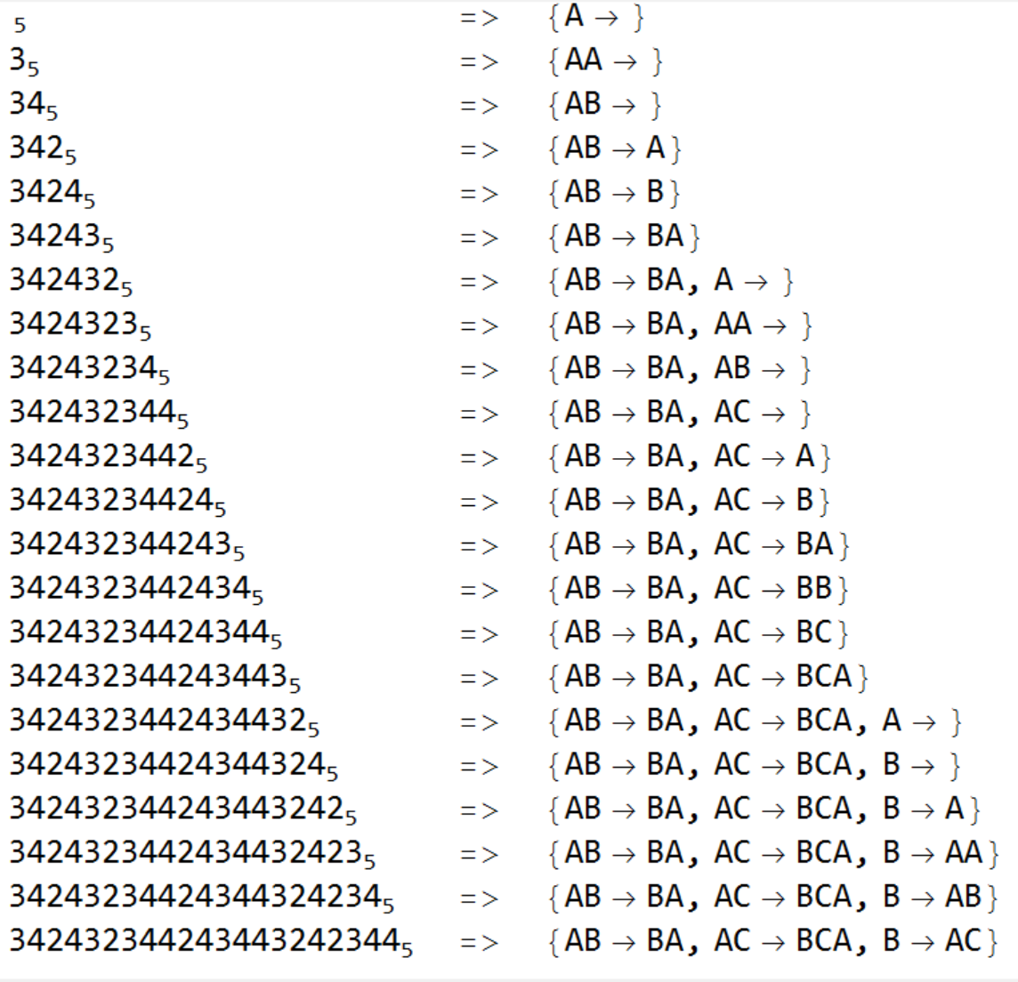
Base-5 digit meanings:
0. End this string, insert two empty strings and start a new string with an “A”.
1. End this string, insert one empty string and start a new string with an “A”.
2. End this string and start a new string with an “A”.
3. End this character and start a new character (as an “A”).
4. Increment this character.
Ruleset under construction:
Notes:
Camille, can you make the window at the bottom scroll up?
After all the code digits are scanned, the complete ruleset has been built. Wait, that was too fast!

Slide 24
Base-5 digit meanings:
0. End this string, insert two empty strings and start a new string with an “A”.
1. End this string, insert one empty string and start a new string with an “A”.
2. End this string and start a new string with an “A”.
3. End this character and start a new character (as an “A”).
4. Increment this character.
EmptyEmpty
Empty
START
APPEND
INCREMENT
Digit being treated: 342432344243443242344
Ruleset under construction:
Start: {“A”}
Notes:
Let’s look at it one step at a time. Even before we look at any of the digits, we start the ruleset with a single “A”.

Slide 25
Base-5 digit meanings:
0. End this string, insert two empty strings and start a new string with an “A”.
1. End this string, insert one empty string and start a new string with an “A”.
2. End this string and start a new string with an “A”.
3. End this character and start a new character (as an “A”).
4. Increment this character.
START
APPEND
INCREMENT
Digit being treated: 342432344243443242344
Ruleset under construction:
{“A”}
=> {“AA”}
Notes:
3 means “append an A”

Slide 26
Base-5 digit meanings:
0. End this string, insert two empty strings and start a new string with an “A”.
1. End this string, insert one empty string and start a new string with an “A”.
2. End this string and start a new string with an “A”.
3. End this character and start a new character (as an “A”).
4. Increment this character.
START
APPEND
INCREMENT
Digit being treated: 342432344243443242344
Ruleset under construction:
{“AA”}
=> {“AB”}
Notes:
4 means “increment the final character”

Slide 27
Base-5 digit meanings:
0. End this string, insert two empty strings and start a new string with an “A”.
1. End this string, insert one empty string and start a new string with an “A”.
2. End this string and start a new string with an “A”.
3. End this character and start a new character (as an “A”).
4. Increment this character.
START
APPEND
INCREMENT
Digit being treated: 342432344243443242344
Ruleset under construction:
{“AB”}
=> {“AB”->“A”}
Notes:
2 means “end this string and start a new string with a single A”

Slide 28
Base-5 digit meanings:
0. End this string, insert two empty strings and start a new string with an “A”.
1. End this string, insert one empty string and start a new string with an “A”.
2. End this string and start a new string with an “A”.
3. End this character and start a new character (as an “A”).
4. Increment this character.
START
APPEND
INCREMENT
Digit being treated: 342432344243443242344
Ruleset under construction:
{“AB”->“A”}
=> {“AB”->“B”}
Notes:
Increment the A to become a B

Slide 29
Base-5 digit meanings:
0. End this string, insert two empty strings and start a new string with an “A”.
1. End this string, insert one empty string and start a new string with an “A”.
2. End this string and start a new string with an “A”.
3. End this character and start a new character (as an “A”).
4. Increment this character.
START
APPEND
INCREMENT
Digit being treated: 342432344243443242344
Ruleset under construction:
{“AB”->“B”}
=> {“AB”->“BA”}
Notes:
Append an A

Slide 30
Base-5 digit meanings:
0. End this string, insert two empty strings and start a new string with an “A”.
1. End this string, insert one empty string and start a new string with an “A”.
2. End this string and start a new string with an “A”.
3. End this character and start a new character (as an “A”).
4. Increment this character.
START
APPEND
INCREMENT
Digit being treated: 342432344243443242344
Ruleset under construction:
{“AB”->“BA”}
=> {“AB”->“BA”, “A”}
Notes:
Start a new string

Slide 31
Base-5 digit meanings:
0. End this string, insert two empty strings and start a new string with an “A”.
1. End this string, insert one empty string and start a new string with an “A”.
2. End this string and start a new string with an “A”.
3. End this character and start a new character (as an “A”).
4. Increment this character.
START
APPEND
INCREMENT
Digit being treated: 342432344243443242344
Ruleset under construction:
{“AB”->“BA”, “A”}
=> {“AB”->“BA”, “AA”}
Notes:
Append an A

Slide 32
Base-5 digit meanings:
0. End this string, insert two empty strings and start a new string with an “A”.
1. End this string, insert one empty string and start a new string with an “A”.
2. End this string and start a new string with an “A”.
3. End this character and start a new character (as an “A”).
4. Increment this character.
START
APPEND
INCREMENT
Digit being treated: 342432344243443242344
Ruleset under construction:
{“AB”->“BA”, “AA”}
=> {“AB”->“BA”, “AB”}
Notes:
Increment the A to become a B

Slide 33
Base-5 digit meanings:
0. End this string, insert two empty strings and start a new string with an “A”.
1. End this string, insert one empty string and start a new string with an “A”.
2. End this string and start a new string with an “A”.
3. End this character and start a new character (as an “A”).
4. Increment this character.
START
APPEND
INCREMENT
Digit being treated: 342432344243443242344
Ruleset under construction:
{“AB”->“BA”, “AB”}
=> {“AB”->“BA”, “AC”}
Notes:
Increment the B to become a C

Slide 34
Base-5 digit meanings:
0. End this string, insert two empty strings and start a new string with an “A”.
1. End this string, insert one empty string and start a new string with an “A”.
2. End this string and start a new string with an “A”.
3. End this character and start a new character (as an “A”).
4. Increment this character.
START
APPEND
INCREMENT
Digit being treated: 342432344243443242344
Ruleset under construction:
{“AB”->“BA”, “AC”}
=> {“AB”->“BA”, “AC”->“A”}
Notes:
Start a new string

Slide 35
Base-5 digit meanings:
0. End this string, insert two empty strings and start a new string with an “A”.
1. End this string, insert one empty string and start a new string with an “A”.
2. End this string and start a new string with an “A”.
3. End this character and start a new character (as an “A”).
4. Increment this character.
START
APPEND
INCREMENT
Digit being treated: 342432344243443242344
Ruleset under construction:
{“AB”->“BA”, “AC”->“A”}
=> {“AB”->“BA”, “AC”->“B”}
Notes:
Increment

Slide 36
Base-5 digit meanings:
0. End this string, insert two empty strings and start a new string with an “A”.
1. End this string, insert one empty string and start a new string with an “A”.
2. End this string and start a new string with an “A”.
3. End this character and start a new character (as an “A”).
4. Increment this character.
START
APPEND
INCREMENT
Digit being treated: 342432344243443242344
Ruleset under construction:
{“AB”->“BA”, “AC”->“B”}
=> {“AB”->“BA”, “AC”->“BA”}
Notes:
Append

Slide 37
Base-5 digit meanings:
0. End this string, insert two empty strings and start a new string with an “A”.
1. End this string, insert one empty string and start a new string with an “A”.
2. End this string and start a new string with an “A”.
3. End this character and start a new character (as an “A”).
4. Increment this character.
START
APPEND
INCREMENT
Digit being treated: 342432344243443242344
Ruleset under construction:
{“AB”->“BA”, “AC”->“BA”}
=> {“AB”->“BA”, “AC”->“BB”}
Notes:
Increment

Slide 38
Base-5 digit meanings:
0. End this string, insert two empty strings and start a new string with an “A”.
1. End this string, insert one empty string and start a new string with an “A”.
2. End this string and start a new string with an “A”.
3. End this character and start a new character (as an “A”).
4. Increment this character.
START
APPEND
INCREMENT
Digit being treated: 342432344243443242344
Ruleset under construction:
{“AB”->“BA”, “AC”->“BB”}
=> {“AB”->“BA”, “AC”->“BC”}
Notes:
Increment

Slide 39
Base-5 digit meanings:
0. End this string, insert two empty strings and start a new string with an “A”.
1. End this string, insert one empty string and start a new string with an “A”.
2. End this string and start a new string with an “A”.
3. End this character and start a new character (as an “A”).
4. Increment this character.
START
APPEND
INCREMENT
Digit being treated: 342432344243443242344
Ruleset under construction:
{“AB”->“BA”, “AC”->“BC”}
=> {“AB”->“BA”, “AC”->“BCA”}
Notes:
Append

Slide 40
Base-5 digit meanings:
0. End this string, insert two empty strings and start a new string with an “A”.
1. End this string, insert one empty string and start a new string with an “A”.
2. End this string and start a new string with an “A”.
3. End this character and start a new character (as an “A”).
4. Increment this character.
START
APPEND
INCREMENT
Digit being treated: 342432344243443242344
Ruleset under construction:
{“AB”->“BA”, “AC”->“BCA”}
=> {“AB”->“BA”, “AC”->“BCA”, “A”}
Notes:
Start a new string

Slide 41
Base-5 digit meanings:
0. End this string, insert two empty strings and start a new string with an “A”.
1. End this string, insert one empty string and start a new string with an “A”.
2. End this string and start a new string with an “A”.
3. End this character and start a new character (as an “A”).
4. Increment this character.
START
APPEND
INCREMENT
Digit being treated: 342432344243443242344
Ruleset under construction:
{“AB”->“BA”, “AC”->“BCA”, “A”}
=> {“AB”->“BA”, “AC”->“BCA”, “B”}
Notes:
Increment

Slide 42
Base-5 digit meanings:
0. End this string, insert two empty strings and start a new string with an “A”.
1. End this string, insert one empty string and start a new string with an “A”.
2. End this string and start a new string with an “A”.
3. End this character and start a new character (as an “A”).
4. Increment this character.
START
APPEND
INCREMENT
Digit being treated: 342432344243443242344
Ruleset under construction:
{“AB”->“BA”, “AC”->“BCA”, “B”}
=> {“AB”->“BA”, “AC”->“BCA”, “B”->“A”}
Notes:
Start a new string

Slide 43
Base-5 digit meanings:
0. End this string, insert two empty strings and start a new string with an “A”.
1. End this string, insert one empty string and start a new string with an “A”.
2. End this string and start a new string with an “A”.
3. End this character and start a new character (as an “A”).
4. Increment this character.
START
APPEND
INCREMENT
Digit being treated: 342432344243443242344
Ruleset under construction:
{“AB”->“BA”, “AC”->“BCA”, “B”->“A”}
=> {“AB”->“BA”, “AC”->“BCA”, “B”->“AA”}
Notes:
Append

Slide 44
Base-5 digit meanings:
0. End this string, insert two empty strings and start a new string with an “A”.
1. End this string, insert one empty string and start a new string with an “A”.
2. End this string and start a new string with an “A”.
3. End this character and start a new character (as an “A”).
4. Increment this character.
START
APPEND
INCREMENT
Digit being treated: 342432344243443242344
Ruleset under construction:
{“AB”->“BA”, “AC”->“BCA”, “B”->“AA”}
=> {“AB”->“BA”, “AC”->“BCA”, “B”->“AB”}
Notes:
Increment

Slide 45
Base-5 digit meanings:
0. End this string, insert two empty strings and start a new string with an “A”.
1. End this string, insert one empty string and start a new string with an “A”.
2. End this string and start a new string with an “A”.
3. End this character and start a new character (as an “A”).
4. Increment this character.
START
APPEND
INCREMENT
Digit being treated: 342432344243443242344
Ruleset under construction:
{“AB”->“BA”, “AC”->“BCA”, “B”->“AB”}
=> {“AB”->“BA”, “AC”->“BCA”, “B”->“AC”}
Notes:
Increment

Slide 46
Base-5 digit meanings:
0. End this string, insert two empty strings and start a new string with an “A”.
1. End this string, insert one empty string and start a new string with an “A”.
2. End this string and start a new string with an “A”.
3. End this character and start a new character (as an “A”).
4. Increment this character.
Digit being treated: 342432344243443242344
Ruleset under construction:
{“AB”->“BA”, “AC”->“BCA”, “B”->“AC”}
DONE!
Notes:
Every base-5 code number results in a unique sequential substitution system ruleset. But let’s look at another example, …

Slide 47
But getting back to research with students….
Notice that by construction the initial part of the ruleset is created by the initial part of the code number, so as we advance through the enumeration of ALL sessie rulesets, we see that for a long time the initial part of the ruleset remains constant.
The real use for this knowledge is to be able to jump through rulesets to more interesting sections that we need to study.
If there is some rule conflict early in a ruleset, we can jump past all rulesets that share that same problem, moving on to other cases without any danger of skipping something interesting.

Slide 48

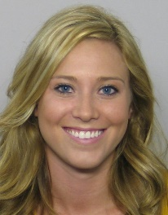


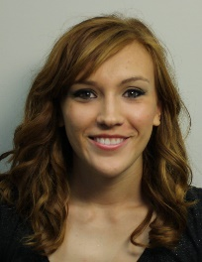



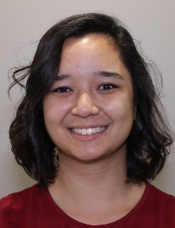





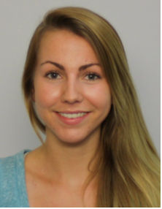

Engineering
Engineering
Mathematics
Biophysics
Mathematics
Math/Chemistry
W11
W10
W12
F14
W18
W20
Breanna Bowden-Green
Kelsey Dobbs
Amy Bead
Christen Case
Camille Morrow
Victoria Kratzke
1. Human inspection of networks.
2. Mathematical treatment of network properties.
3. Improved enumeration & acceleration.
Nursing
Biochemistry
Mathematics
Researchers in the SESSIE project Southern Adventist University
F16
W17
W20
Lucas Valenca
Drew Blake
Sarah Wu
4. Logic & Planning
Computer Sci. & Embedded Sys.
Physics
Bio/Premed
Biophys/Spanish
W20
W21
S19
W19
W19
Josh Wade
Jonathan Ziesmer
Miro Manestar
Micah Tanner
Jade Deschamps
Jeanna Toulouse
Christofer Trana
6. Translation
7. Identifying Networks Mathematically
5. Programming

Slide 49
Student presentations →→ Better Explanations
“Translations” for the public?!
Jade Deschamps: Step-by-step animated explanation!

Slide 50
BUILDING SESSIES STEP BY STEP
Dr. Caviness
Jade Deschamps
3/16/2017

Slide 51
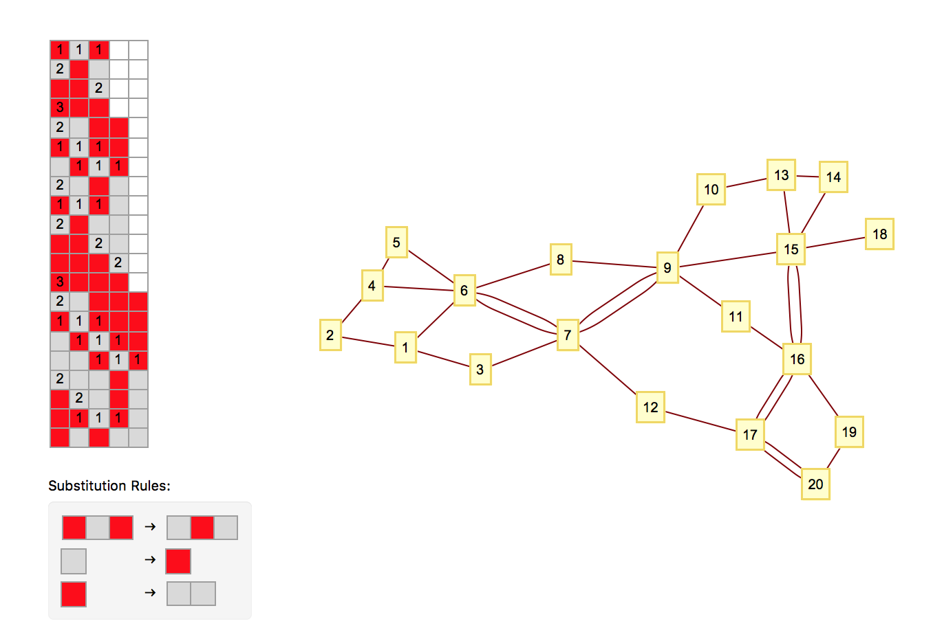
This is a “S.e.S.S.i.e” (Sequential Substitution System)
Three Basic Components:
The Ruleset
The “Sessie” (the gray and red grid)
The Network (nodes = yellow boxes)

Slide 52
The 4 Basic Principles
1. Rules cause Sessies to change.
They destroy old blocks and exchange them for new blocks.
2. We read Sessies from left to right
3. We use only 1 rule per row, and
use the 1st row that works.
4. A Yellow Box means a rule was used.
Gray horizontal lines pair with yellow boxes. (How the boxes connect will be introduced later).
Sessie (aka a grid of cells)
Node 1
Node 2
Node 3
Node 4
And so on
Yellow box 1 w/ Node 1, Box 2 w/ Node 2… and so on.

Slide 53
You can start with any state string. This one is “BAB”. (Red-Gray-red corresponds to B-A-B)
This row matches Rule 1
Rule 1
We only use the first “substitution rule” that works.
Notes:
No rules used: only state string: no nodes

Slide 54
Numbers convey that Rule 1 matched with these cells
rule applications occur “between” rows
1 Rule application → creates 1 node
Exchanging the old row, for this new one below it.
Node 1
Rule 1
Notes:
1 node from 1 rule used

Slide 55
Node 2
Which rule would we use next?
Why are they connected?
Node 2
When new node exchanges the blocks of an old node, a line links the nodes!
Implications:
Let’s say a new node destroyed 3 older blocks, but, these blocks came from 3 different nodes. How many links would the new node have?
Notes:
2 rules used: 2 connected nodes
CONNECTED – 1 cell created by event 1, destroyed by event 2
Identify: what rule was used in row 2? - second rule (see “2” in row 2)
→ Single connection

Slide 56
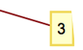

Node 1
Node 2
Node 3
Rule 2
So, given , what rule would we use for Node 3?
Remember:
Read Sessie L from R
Use the first rule that works
Applying this rule “creates” node 3.
Rule 2
Notes:
2 rules used: 2 connected nodes
CONNECTED – 1 cell created by event 1, destroyed by event 2
Identify: what rule was used in row 2? - second rule (see “2” in row 2)
→ Single connection

Slide 57
Rule 2
If node 1 created a block,
and node 3 replaced that block,
then they must be connected.
T
This is this is the basic premise of building Sessies.
Notes:
Identify- nodes 1 and 3 are connected.

Slide 60
3 Links at once!!
See “ 1 1 1”
Let’s go back to our previous implication:
“Let’s say a new node destroyed 2 older blocks, but, these blocks came from two different nodes. How many links would the new node have?”
Notes:
Row 6: 1 1 1 : replaced 3 nodes that were originally formed from 3 different places

Slide 62
Here we have Node 7 connected twice to Node 6. Why might that be?
Simply because Node 7 exchanged two block from Node 6.
Notes:
6 created 2 cells that 7 destroyed: therefore, 2 connections.
Let’s find them on the sessie grid.

Slide 75
Intro to Identifying Networks
A Look at Sequential Substitution Systems
By: Jeanna Toulouse
Chris Trana
Dr. Ken Caviness

Slide 76
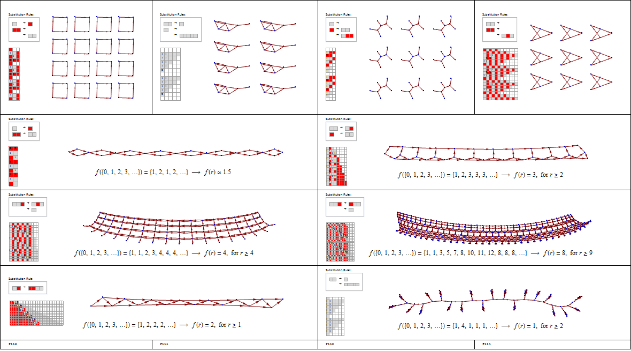
Rule Sets → Sessies → Networks

Slide 77
Different Rule Sets → Different Sessies → Different Networks

Slide 78
Different Rule Sets → Different Sessies → Different Networks

Slide 79
Different Rule Sets → Different Sessies → Different Networks

Slide 80
Network dimension
0: Does not extend in any direction
No network or dies out
Infinitely repeating separate clumps, increasingly complex

Slide 81
Network dimension
0: Does not extend in any direction
1: Extends in only one direction
May have more dimensions on small scale
Like the hidden dimensions of String Theory

Slide 82
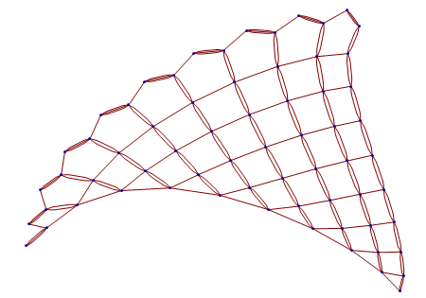
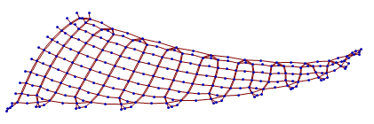
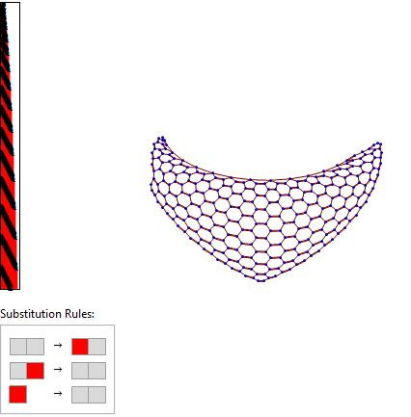
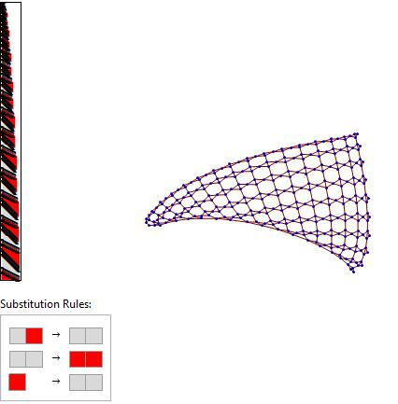
Network dimension
2: Extends (forever) in two directions

Slide 83
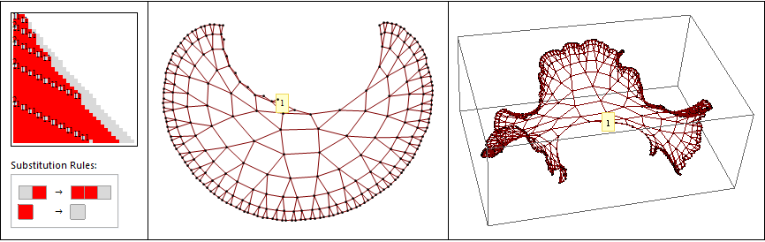
Network dimension
3: Three-dimensional growth?
Maybe not, getting infinitely dense → Exponential Growth

Slide 84
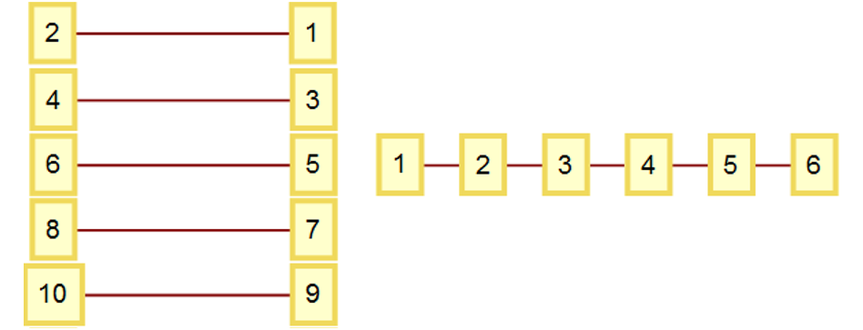
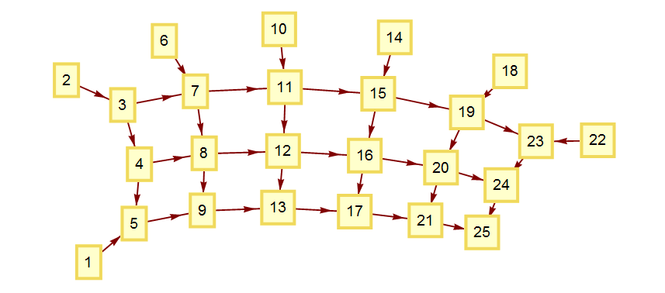
Identifying Networks
Mathematically!
Check whether it’s new or not
Jeanna Toulouse
W19
Christofer Trana
W19
Any 1-d network “summarized” compactly:
Another example:
Network | {1→2, 3→4, 5→6, 7→8, …} | {1→2, 2→3, 3→4, 5→6, …}
Link Length Set List | {{1},{},{1},{},{1},{},{1}, {},{1},{},…} | {{1},{1},{1},{1},{1},…}
Summary | {{1},{}} | {{1}}
Network | {{1→5, 2→3, 3→4, 3→7, 4→5, 4→8, 5→9, 6→7, 7→8, 7→11, 8→9, 8→12, 9→13, 10→11, 11→12, 11→15, 12→13, 12→16, 13→17, 14→15, 15→16, 15→19, 16→17, 16→20, 17→21, 18→19, 19→20, 19→23, 20→21, 20→24, 21→25, 22→23, 23→24, 24→25}}
Link Length Set List | {{4}, {1}, {1,4}, {1,4}, {4}, {1}, {1,4}, {1,4}, {4}, {1}, {1,4}, {1, 4}, {4}, {1}, {1,4}, {1,4}, {4}, {1}, {1,4}, {1,4}, {4}, {1}, {1}, {1}}
Summary | {{4}, {1}, {1,4}, {1,4}}

Slide 85
Take Summaries & Convert them into a Mathematical Definition

Slide 86
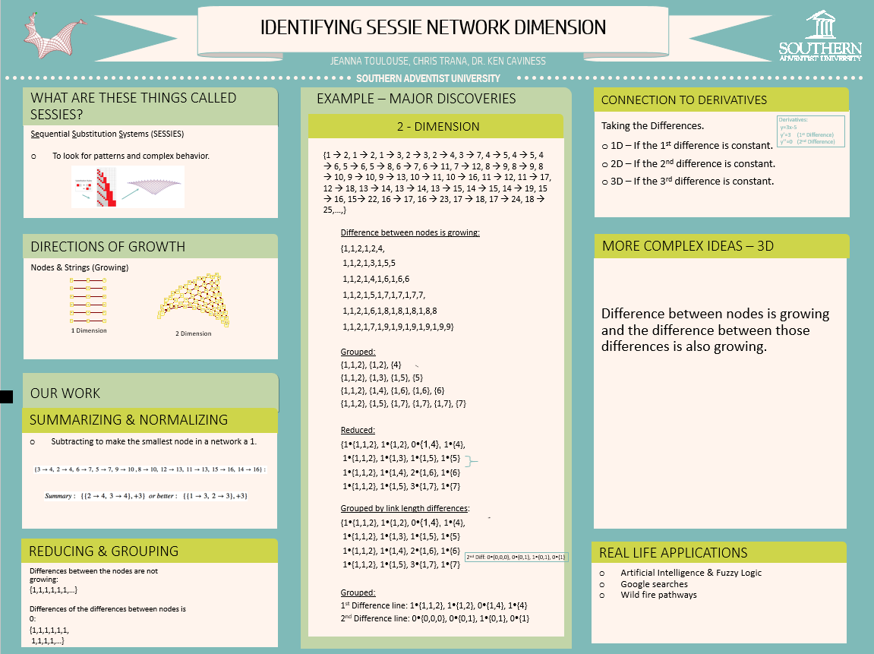
Research Day Poster Session

Slide 87
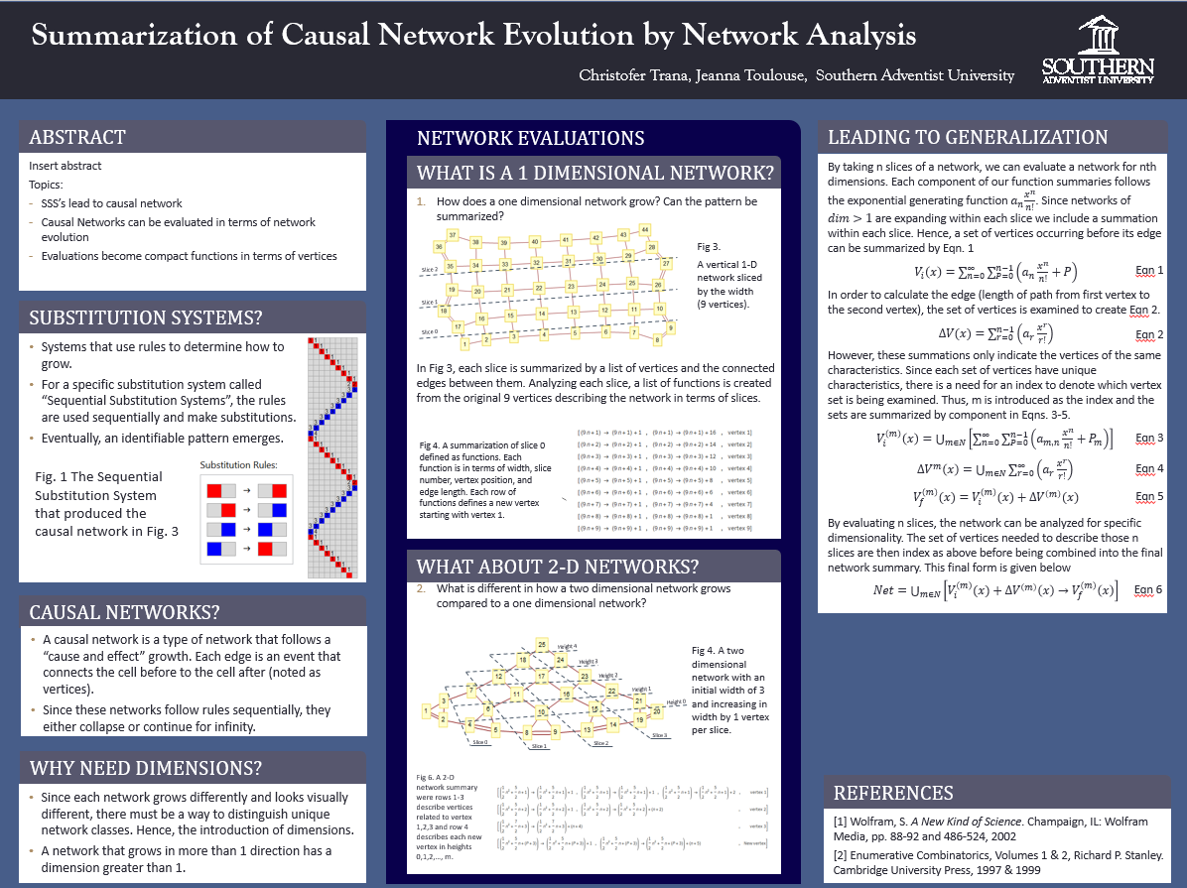
Research Day Poster Session
Notes:
Section: “What is a 1 dimensional network?”,
Description: Describes 1-D networks and how to go from the network (fig 3) to the function summary (fig 4).
- Note each row of functions describe a vertex (an intersection labeled numerically… the top right “intersection” is 1 hence the first row of fig. 4 describes the network for all vertices related to vertex 1 which are labeled in fig 3. as 1, 10, 19, 28, 37,…)
- Note a 1-D function is created by “the average slice width” times “the slice number n” plus “the position of the first vertex in a series” and is “mapped” to the connected vertices (which increase by the length of the edge (length from beginning to ending vertex))
Hence, the functions for all vertices related to vertex 1 are (9n+1) -> (9n+1)+1 and (9n+1) -> (9n+1)+16 since vertex 1 in fig 3. is connected to vertex 2 and 17. Similarly, vertex 10 is connected to 11 and 26.
Section: “What makes a network 2 dimensional?”
Description: Describes a 2-D network and how to go from the network (fig 5) to the function summary (fig 6).
- Note similar process to the previous section. However, this time we have a quadratic function which accounts for the new vertex in each slice.
- Note a 2-D function is created by “the average slice width change divided by 2” times “the slice number n squared” plus “the average slice width (for the first two slices) minus the average slice width change” times “slice number n” plus “the position of the first
vertex in slice 0” and is “mapped” to the connected vertices (which increase by the length of the edge (length from beginning to ending vertex)).
Hence, the functions for all vertices related to vertex 1 are ($\frac{1}{2}n^{2}+\frac{5}{2}n+1)→\text{(}\frac{1}{2}n^{2}+\frac{5}{2}n+1)+1,\text{(}\frac{1}{2}n^{2}+\frac{5}{2}n+1)→\text{(}\frac{1}{2}n^{2}+\frac{5}{2}n+1)+1$, and $(\frac{1}{2}n^{2}+\frac{5}{2}n+1)→\text{(}\frac{1}{2}n^{2}+\frac{5}{2}n+1)+2$ since vertex 1 in fig 6. is connected to vertex 2 (twice) and 3. Similarly, vertex 4 is
connected to 5 (twice) and 6.
- Note this formula is complicated because each vertex function located after the location of the growth vertices has to change to account for the growth. Hence, the n term is larger for function towards the end of the slice than the first most function.

Slide 88
Just Skip it
Research Day Presentation
Camille Morrow
Ignoring Repetitive Behaviors in the "Sessie" Enumeration

Slide 89
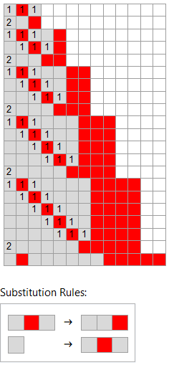
What is a Sessie?
Sequential Substitution Systems (SSSs) or “Sessies” are structures created by a series of rule sets that can describe a series of behaviors.
They can model absolutely anything, but some behaviors are simpler than others.

Slide 90
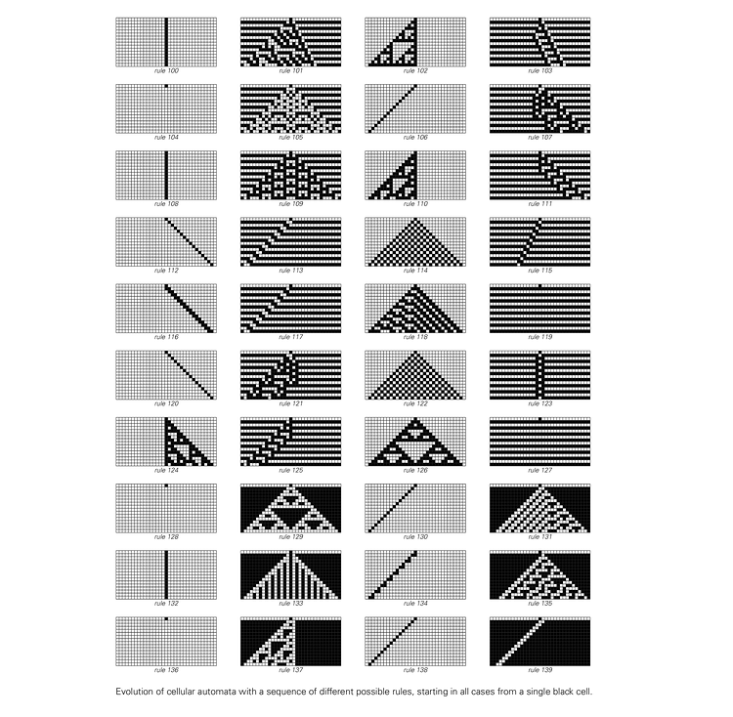
What are they good for?
Stephen Wolfram’s book, A New Kind of Science, shows the sort of behaviors we can model
Kenneth Caviness’s enumeration lists all possible rule sets

Slide 91
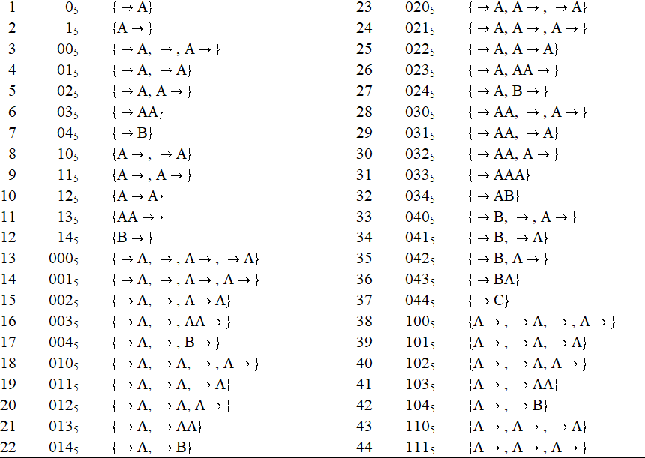
Quinary
The simpler behaviors will occur earlier in the enumeration.
We can label each set of rules with a number, but it helps us to use a new numbering system, which we call quinary.

Slide 92
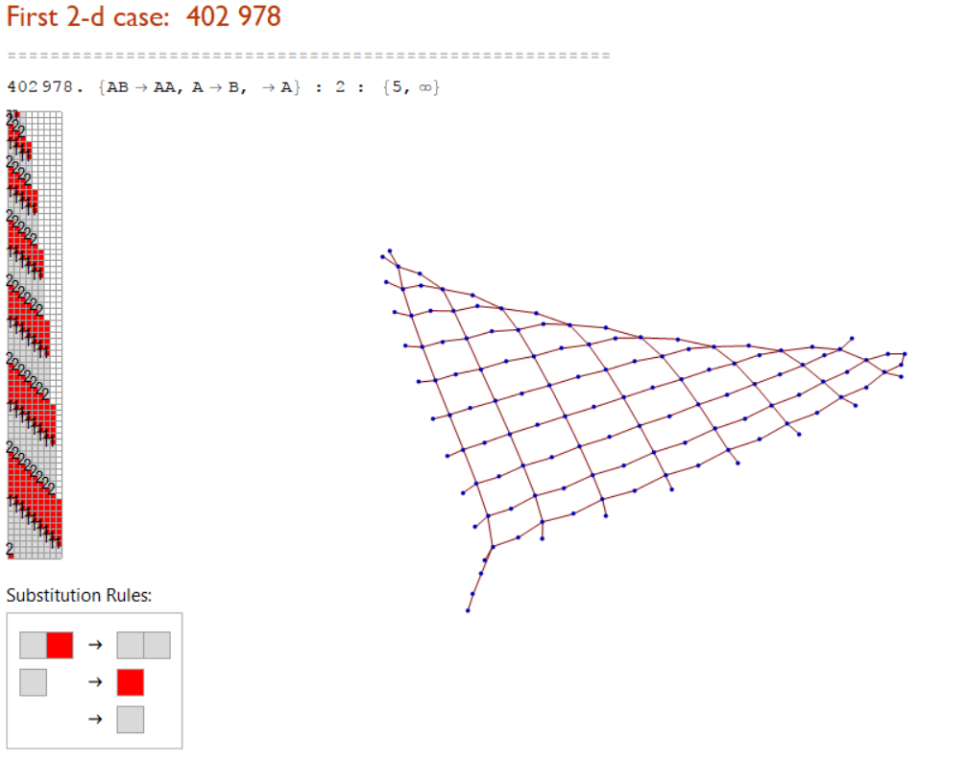
Why skip through the list?
We are able to cover more ground on this infinite list.
Interesting cases would take too long to find without skipping.

Slide 93
Why involve students?
To give them research experience
Brainstorming – new thoughts!
Generalized SSS Enumeration
Improved explanations
Real contributions, actual publications
https://www.complex-systems.com/abstracts/v29_i04_a04/

Slide 94
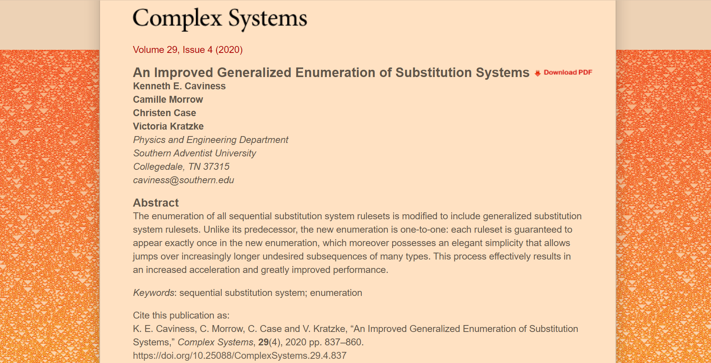

Slide 95

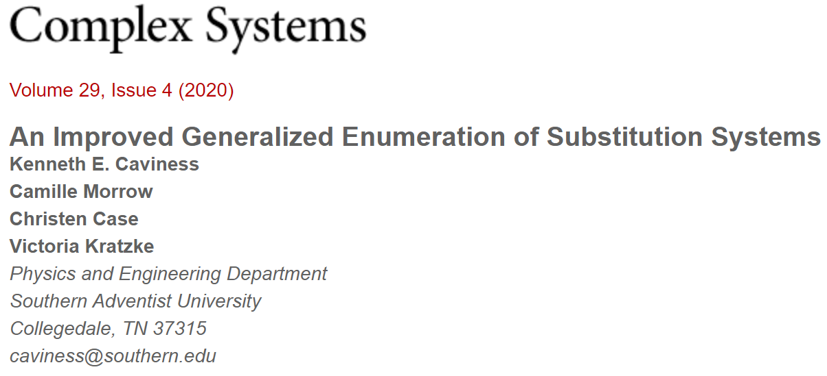
Team Effort
All of us needed!
Christen:
Insight that led to GSS
Painstaking work on “Long Jumps”
Camille:
Initial Draft of Paper
Continued treatment of LJ conditions
Victoria:
Additional LJ examples
Checking all examples
Complete Rewrite & Polish
KC:
Original idea, programming, GSS, continuity of research track

Slide 96
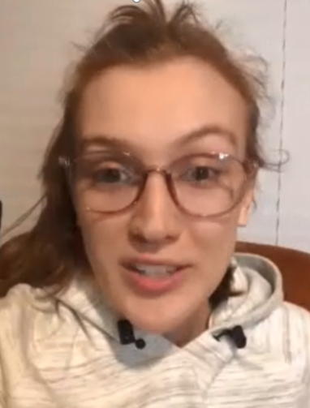
Camille Morrow Gonzalez

Slide 97

Christen Case Thompson

Slide 98
SESSIE NetWorks
Lots of opportunities for future research!
DONE!
(and so are we)
Have a good week! ☺

